Slide 1
A Study into Optimizing the Number of Cashier
Employees in Manuel Supermarket
Final Project Presentation TEAM#5

Slide 2

Agenda
Introduction.
Purpose of project
Literature Review.
Problem Statement.
Data Collection
Generate & Evaluate Alternatives.
Results.
Recommendations.
Conclusion.

Slide 3
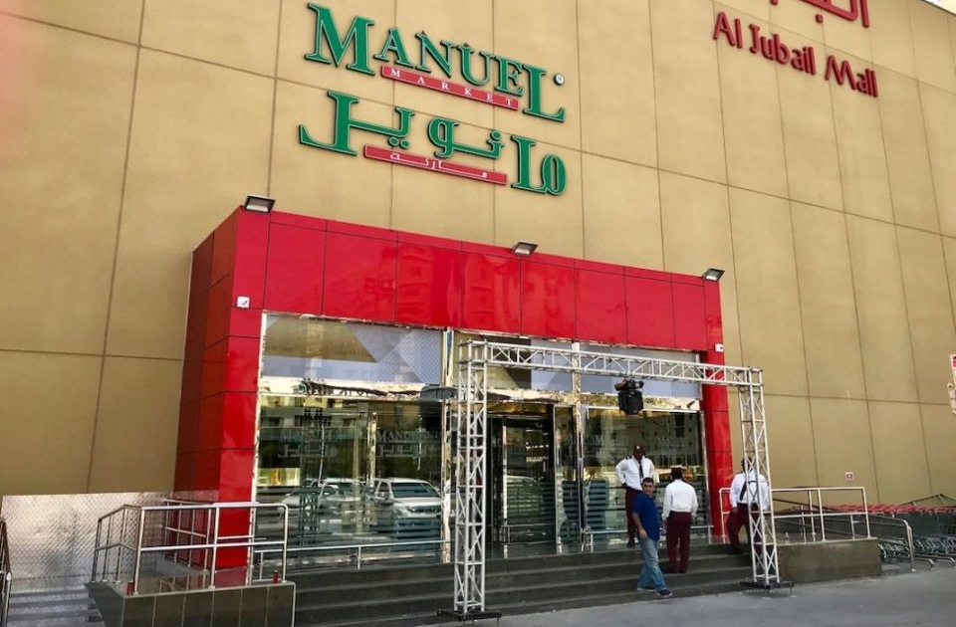

1
Introduction
Notes:
Nowadays, in a world full of Competitions, organizations and enterprises, especially the companies that need store to sell products, are suffering from the employees shifts
Manuel is a Saudi brand that established in
Manual-Al-batarjee branch is one of the enterprises that is suffering from this problem
The tool that will be used in this project in order to get as much accurate results as possible is “integer linear programming module”
a full variety of cashier’s workers are decreased with keeping the required variety of cashier workers in every shift consummated

Slide 4
1
Aims & Objectives
Aims:
Minimize the overhead cost at supermarket branches.
Decrease the number of cashiers without loss in efficiency.
Objectives:
Optimizing the number of cashiers in a local Manuel supermarket branch in Jeddah.
Finding best allocation of human resources.

Slide 5

Purpose of project
Reduce the number of workers in the cashiers, which will logically reduce the salary cost on the company’s finances

Slide 6

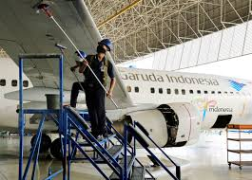
Literature Review
2
Ex.1 “Aircraft Maintenance Workforce Scheduling”

Slide 7


Literature Review
2
Ex.2 “Staff Scheduling and Rostering”

Slide 8
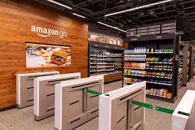
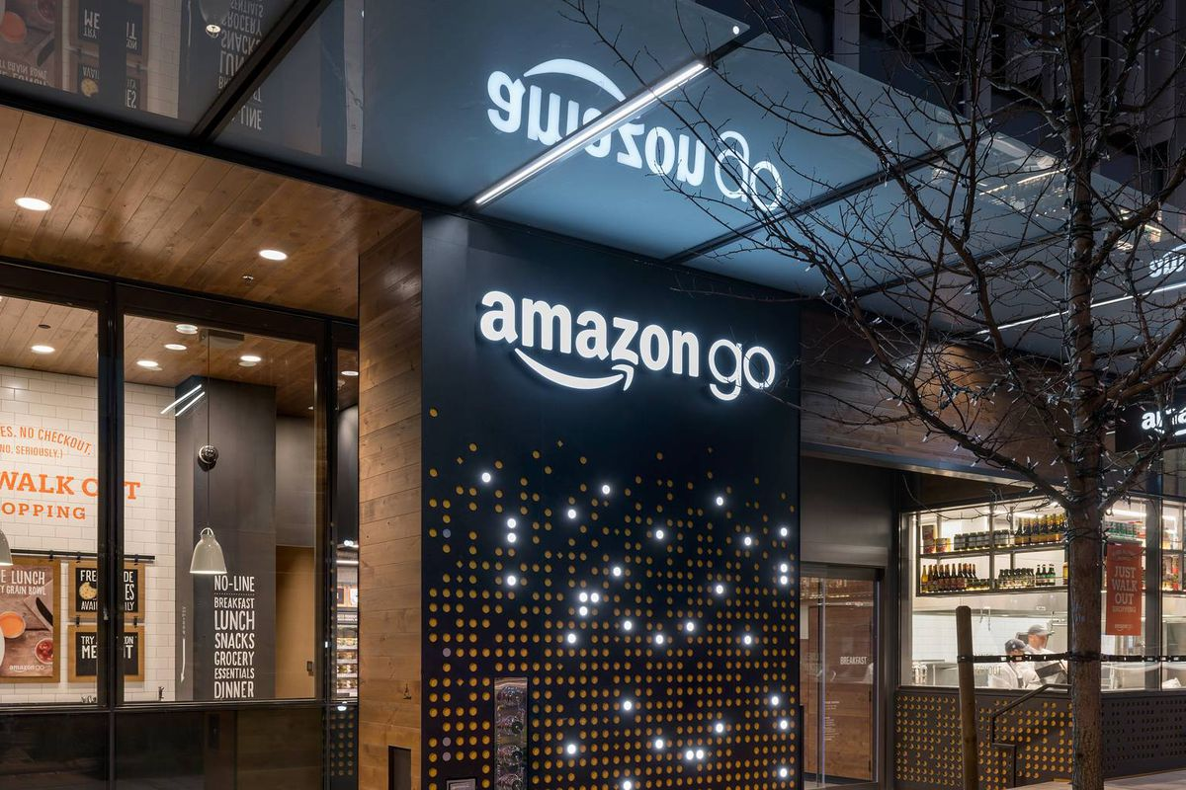
Literature Review
2
Ex.3 “Amazon Cashier-Less Stores”

Slide 9
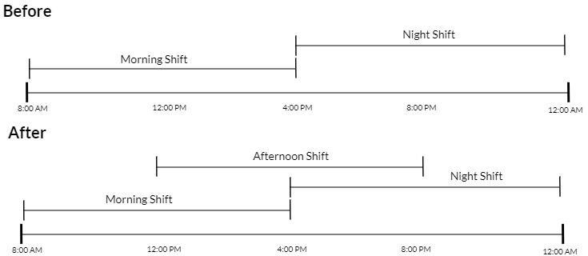
3
Problem Statement
The problem :
The Number of cashiers in the current system, which are more than the supermarket needs.

Slide 10


3
Data Collection
DAYS OF THE WEEK | SUN | MON | TUES | WED | THURS | FRI | SAT
NUMBER OF CASHIERS | 10 | 10 | 10 | 10 | 12 | 18 | 10

Slide 11
3
Requirements
Satisfying the demand of each day.
Customers shouldn’t wait a long time in the line.
The Employee shouldn’t work more than 8 hours per day.

Slide 12
4
Generate & Evaluate Alternatives
1
Generate Alternatives.
2
Evaluate Alternatives.
3
Selection of Best Alternatives

Slide 13
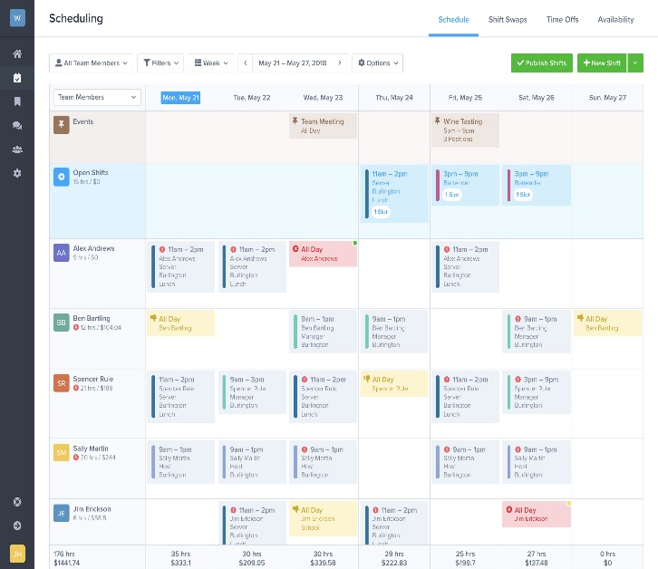
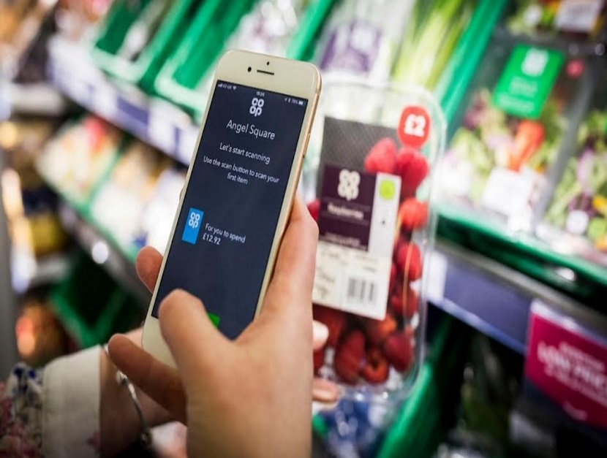
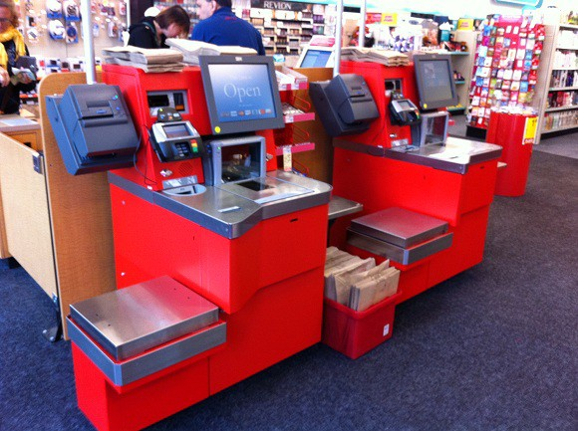
4
Generate Alternatives
New scheduling
Cashier-less technology
Self-checkout machines

Slide 14
4
Evaluate Alternatives
Cost
Ease of Use
Ease of Implementation
Customer Satisfaction
Time

Slide 15
4
Selection of Best Alternatives
Criteria | Weighting | New scheduling |  | Cashier-less technology |  | Self-checkout machines
 |  | Score | Total | Score | Total | Score | Total
cost | 5 | 5 | 25 | 1 | 5 | 2 | 10
ease of use | 3 | 3 | 9 | 2 | 6 | 5 | 15
ease of implementation | 4 | 5 | 20 | 2 | 8 | 3 | 12
customer satisfaction | 5 | 2 | 10 | 5 | 25 | 5 | 25
time | 4 | 5 | 20 | 1 | 4 | 2 | 8
Total |  |  | 84 |  | 48 |  | 70
Cost : from most expensive (1) to least expensive (5)
Time : (1) long time to (5) short time
Notes:
Weighted decision matrix

Slide 16
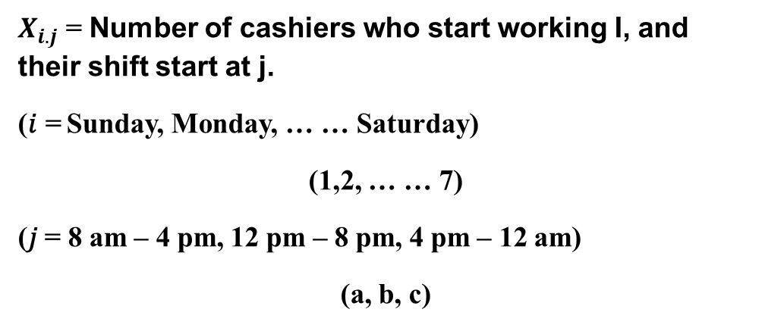
5
Formulation
Decision Variables
$X_{i.j}$ = Number of cashiers who start working I, and their shift start at j.
(𝑖 = Sunday, Monday, … … Saturday)
(1,2, … … 7)
(𝑗 = 8 am – 4 pm, 12 pm – 8 pm, 4 pm – 12 am)
(a, b, c)

Slide 17
5
Formulation
Objective Function
The objective is to minimize the number of cashiers for Manuel supermarket.
Constraints
The demand for cashiers each day.

Slide 18
5
Formulation
𝑚𝑖𝑛𝑖𝑚𝑖𝑧𝑒 𝑍 = 𝑥𝑎. 1 + 𝑥𝑎. 2 + 𝑥𝑎. 3 + 𝑥𝑎. 4 + 𝑥𝑎. 5 + 𝑥𝑎. 6 + 𝑥𝑎. 7 + 𝑥𝑏. 1 + 𝑥𝑏. 2 + 𝑥𝑏.3 + 𝑥𝑏.4 + 𝑥𝑏.5 + 𝑥𝑏.6 + 𝑥𝑏.7 + 𝑥𝑐.1 + 𝑥𝑐.2 + 𝑥𝑐.3 + 𝑥𝑐.4 + 𝑥𝑐.5 + 𝑥𝑐.6 + 𝑥𝑐.7
Subject To (constraints);
(𝑎:8𝑎𝑚−4𝑝𝑚)
𝑥𝑎.1 + 𝑥𝑎.4 + 𝑥𝑎.5 + 𝑥𝑎.6 + 𝑥𝑎.7 ≥ 2 (# 𝑜𝑓 𝐶𝑎𝑠h𝑖𝑒𝑟 𝑜𝑛 𝑆𝑢𝑛𝑑𝑎𝑦)
𝑥𝑎.2+𝑥𝑎.5+𝑥𝑎.6+𝑥𝑎.7+𝑥𝑎.1≥2 (#𝑜𝑓𝐶𝑎𝑠h𝑖𝑒𝑟𝑜𝑛𝑀𝑜𝑛𝑎𝑦)
𝑥𝑎.3 + 𝑥𝑎.6 + 𝑥𝑎.7 + 𝑥𝑎.1 + 𝑥𝑎.2 ≥ 2 (# 𝑜𝑓 𝐶𝑎𝑠h𝑖𝑒𝑟 𝑜𝑛 𝑇𝑢𝑒𝑠𝑑𝑎𝑦)
𝑥𝑎.4 + 𝑥𝑎.7 + 𝑥𝑎.1 + 𝑥𝑎.2 + 𝑥𝑎.3 ≥ 2 (# 𝑜𝑓 𝐶𝑎𝑠h𝑖𝑒𝑟 𝑜𝑛 𝑊𝑒𝑑𝑛𝑒𝑠𝑑𝑎𝑦)
𝑥𝑎.5 + 𝑥𝑎.1 + 𝑥𝑎.2 + 𝑥𝑎.3 + 𝑥𝑎.4 ≥ 2 (# 𝑜𝑓 𝐶𝑎𝑠h𝑖𝑒𝑟 𝑜𝑛 𝑇h𝑢𝑟𝑠𝑑𝑎𝑦)
𝑥𝑎.6 + 𝑥𝑎.2 + 𝑥𝑎.3 + 𝑥𝑎.4 + 𝑥𝑎.5 ≥ 4 (# 𝑜𝑓 𝐶𝑎𝑠h𝑖𝑒𝑟 𝑜𝑛 𝐹𝑟𝑖𝑑𝑎𝑦)
𝑥𝑎.7 + 𝑥𝑎.3 + 𝑥𝑎.4 + 𝑥𝑎.5 + 𝑥𝑎.6 ≥ 2 (# 𝑜𝑓 𝐶𝑎𝑠h𝑖𝑒𝑟 𝑜𝑛 𝑆𝑎𝑡𝑢𝑟𝑑𝑎𝑦)

Slide 19
5
Formulation
(𝑏:12𝑝𝑚−8𝑝𝑚)
𝑥𝑏.1+𝑥𝑏.4+𝑥𝑏.5+𝑥𝑏.6+𝑥𝑏.7≥2 (#𝑜𝑓𝐶𝑎𝑠h𝑖𝑒𝑟𝑜𝑛𝑆𝑢𝑛𝑑𝑎𝑦)
𝑥𝑏.2+𝑥𝑏.5+𝑥𝑏.6+𝑥𝑏.7+𝑥𝑏.1≥2 (#𝑜𝑓𝐶𝑎𝑠h𝑖𝑒𝑟𝑜𝑛𝑀𝑜𝑛𝑎𝑦)
𝑥𝑏.3+𝑥𝑏.6+𝑥𝑏.7+𝑥𝑏.1+𝑥𝑏.2≥2 (#𝑜𝑓𝐶𝑎𝑠h𝑖𝑒𝑟𝑜𝑛𝑇𝑢𝑒𝑠𝑑𝑎𝑦) 𝑥𝑏.4+𝑥𝑏.7+𝑥𝑏.1+𝑥𝑏.2+𝑥𝑏.3≥2 (#𝑜𝑓𝐶𝑎𝑠h𝑖𝑒𝑟𝑜𝑛𝑊𝑒𝑑𝑛𝑒𝑠𝑑𝑎𝑦) 𝑥𝑏.5+𝑥𝑏.1+𝑥𝑏.2+𝑥𝑏.3+𝑥𝑏.4≥2 (#𝑜𝑓𝐶𝑎𝑠h𝑖𝑒𝑟𝑜𝑛𝑇h𝑢𝑟𝑠𝑑𝑎𝑦) 𝑥𝑏.6+𝑥𝑏.2+𝑥𝑏.3+𝑥𝑏.4+𝑥𝑏.5≥5 (#𝑜𝑓𝐶𝑎𝑠h𝑖𝑒𝑟𝑜𝑛𝐹𝑟𝑖𝑑𝑎𝑦)
𝑥𝑏.7+𝑥𝑏.3+𝑥𝑏.4+𝑥𝑏.5+𝑥𝑏.6≥2 (#𝑜𝑓𝐶𝑎𝑠h𝑖𝑒𝑟𝑜𝑛𝑆𝑎𝑡𝑢𝑟𝑑𝑎𝑦)
(𝑐:4𝑝𝑚−12𝑎𝑚)
𝑥𝑐.1+𝑥𝑐.4+𝑥𝑐.5+𝑥𝑐.6+𝑥𝑐.7≥6 (#𝑜𝑓𝐶𝑎𝑠h𝑖𝑒𝑟𝑜𝑛𝑆𝑢𝑛𝑑𝑎𝑦)
𝑥𝑐.2+𝑥𝑐.5+𝑥𝑐.6+𝑥𝑐.7+𝑥𝑐.1≥6 (#𝑜𝑓𝐶𝑎𝑠h𝑖𝑒𝑟𝑜𝑛𝑀𝑜𝑛𝑎𝑦)
𝑥𝑐.3+𝑥𝑐.6+𝑥𝑐.7+𝑥𝑐.1+𝑥𝑐2≥6 (#𝑜𝑓𝐶𝑎𝑠h𝑖𝑒𝑟𝑜𝑛𝑇𝑢𝑒𝑠𝑑𝑎𝑦)
𝑥𝑐.4+𝑥𝑐.7+𝑥𝑐.1+𝑥𝑐.2+𝑥𝑐.3≥6 (#𝑜𝑓𝐶𝑎𝑠h𝑖𝑒𝑟𝑜𝑛𝑊𝑒𝑑𝑛𝑒𝑠𝑑𝑎𝑦)
𝑥𝑐.5+𝑥𝑐.1+𝑥𝑐.2+𝑥𝑐.3+𝑥𝑐.4≥8 (#𝑜𝑓𝐶𝑎𝑠h𝑖𝑒𝑟𝑜𝑛𝑇h𝑢𝑟𝑠𝑑𝑎𝑦)
𝑥𝑐.6+𝑥𝑐.2+𝑥𝑐.3+𝑥𝑐.4+𝑥𝑐.5≥9 (#𝑜𝑓𝐶𝑎𝑠h𝑖𝑒𝑟𝑜𝑛𝐹𝑟𝑖𝑑𝑎𝑦)
𝑥𝑐.7+𝑥𝑐.3+𝑥𝑐.4+𝑥𝑐.5+𝑥𝑐.6≥6 (#𝑜𝑓𝐶𝑎𝑠h𝑖𝑒𝑟𝑜𝑛𝑆𝑎𝑡𝑢𝑟𝑑𝑎𝑦)
𝑥𝑖, 𝑗 ≥ 0 (non negativity constraint)

Slide 20
5
Results
The Old Shifting System
Day | Shift | Number of Cashiers
Sunday | 8AM-4PM | 8
 | 4PM-12AM | 11
Monday | 8AM-4PM | 8
 | 4PM-12AM | 11
Tuesday | 8AM-4PM | 8
 | 4PM-12AM | 11
Wednesday | 8AM-4PM | 8
 | 4PM-12AM | 11
Thursday | 8AM-4PM | 14
 | 4PM-12AM | 20
Friday | 8AM-4PM | 22
 | 4PM-12AM | 22
Saturday | 8AM-4PM | 8
 | 4PM-12AM | 12
Summarize | Two Shifts | 29 Cashiers

Slide 21
5
Results
The Old Shifting System

Slide 22
5
Results
The New Shifting System
Day | Shift | Number of Cashiers
Sunday | 8AM-4PM | 3
 | 12PM-8PM | 5
 | 4PM-12AM | 6
Monday | 8AM-4PM | 4
 | 12PM-8PM | 5
 | 4PM-12AM | 10
Tuesday | 8AM-4PM | 2
 | 12PM-8PM | 3
 | 4PM-12AM | 7
Wednesday | 8AM-4PM | 4
 | 12PM-8PM | 5
 | 4PM-12AM | 8
Thursday | 8AM-4PM | 2
 | 12PM-8PM | 2
 | 4PM-12AM | 10
Friday | 8AM-4PM | 4
 | 12PM-8PM | 5
 | 4PM-12AM | 10
Saturday | 8AM-4PM | 4
 | 12PM-8PM | 5
 | 4PM-12AM | 10
Summarize | Three Shifts | 19 Cashiers

Slide 23
6
Recommendations
Training
Advantages of Training
Increased adaptation to the new shifting system
Increased Productivity of employees
Uniformity of Procedures which lead to increase service efficiency

Slide 24
6
Recommendations
Job Enrichment
Advantages of Job Enrichment
It gives the employees more self-management in his duties.
Notes:
Job enrichment is a common motivational technique used by organizations to give an employee greater satisfaction in his work. It means giving an employee additional responsibilities reserved for his manager or other higher-ranking positions

Slide 25

Notes:
Problem Statement.
Data Collection
Results.
Recommendations.

Slide 26

Thank You

